Slide 1
Addressing inequity with innovative and shareable resources and how we made them!
CAUL: Enabling Modern Curriculum Conference
September 7th, 2022
Lightning talk
Dr Azadeh Mobasheri
Learning Designer
RMIT University

Slide 2
Support
The Higher Education Participation and Partnership Program (HEPPP)
has a focus to support students Who are:
From regional and remote Australia
Aboriginal and/or Torres Strait Islander
​From low SES background

Slide 3
Objectives
The key objective is to promote equality of opportunity
in higher education through:​​
Widening aspiration and promoting higher education
Improving access, participation, retention and completion

Slide 4
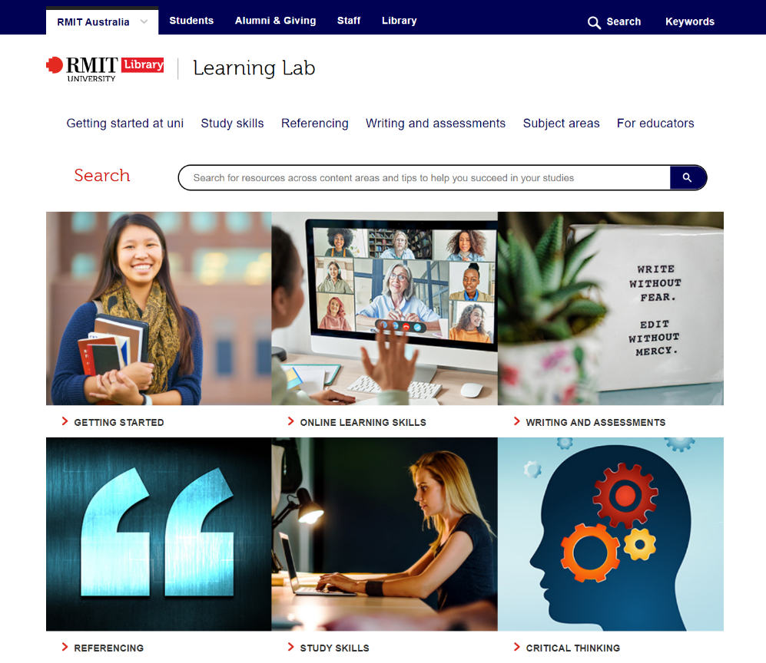
Learning Lab
Provides access to online activities and resources
to help learners build study, writing, maths and English language skills.
Learning Lab Contextualised
Content (LLCC)
Connects learners with the Library’s Learning Lab resources to spark an interest in further study.

Slide 5
Stages
Planning and Analysis
Researching and mapping data
Design
Designing and prototyping Objects
Development
Creating OER resources

Slide 6
Stage 1 – Planning and Analysis
RMIT Equity Enrolment Data
The National Centre for Student Equity in Higher Education (NCSEHE)
Indigenous careers handbook
Emerging industries
Engineering
Human Society
Health
Economics

Slide 7
Stage 1 – Planning and Analysis
RMIT Library Learning Lab data
Course and Learning objectives/outcomes
Math
Physics
Language
Nursing
Social Studies
Communication and collaboration
Digital literacy
Critical thinking
Sustainability

Slide 8
Stage 2 – Content design
Guiding Principles: The 4 Rs
Representation
Learners should be able to see themselves represented in the content
Informed by:
academic papers,
independent reviews,
government statistics and
forecasts,
and equity initiatives
Relevance
Realistic and relevant to them and their lifestyle
Reassurance
Reassure learners that higher education is a valid choice for them
and that they will be given support
Reliability
Demonstrate to learners that it is a source they can trust

Slide 9
Stage 3 - Development
Barriers the HEPPP cohort may face:
Unreliable internet connection
Lack of high-speed infrastructure in their area
Limited access to shared devices, Wi-Fi connections or data plans
Reliance on smartphones rather than computers
Insufficient numbers of computers for learners in schools or regional study centers
Costs related to upgrading devices and internet plans

Slide 10
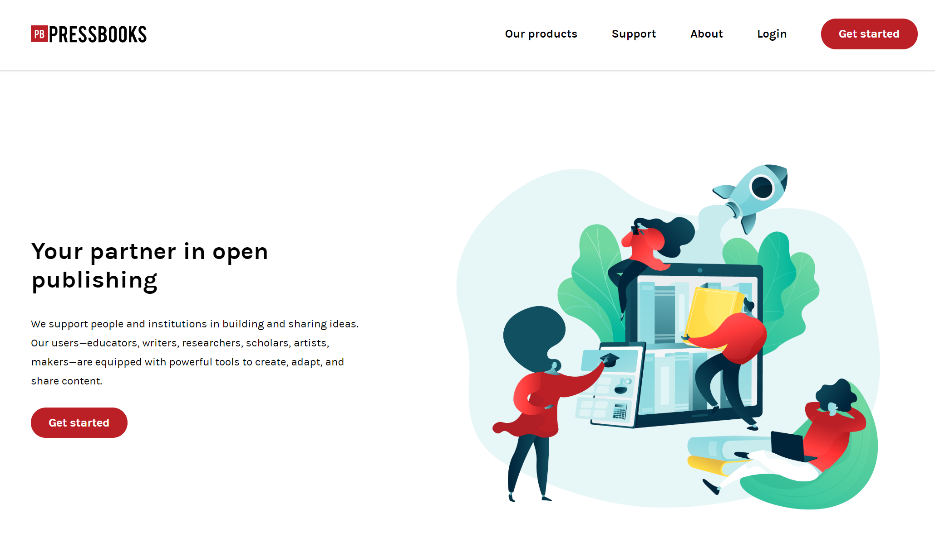
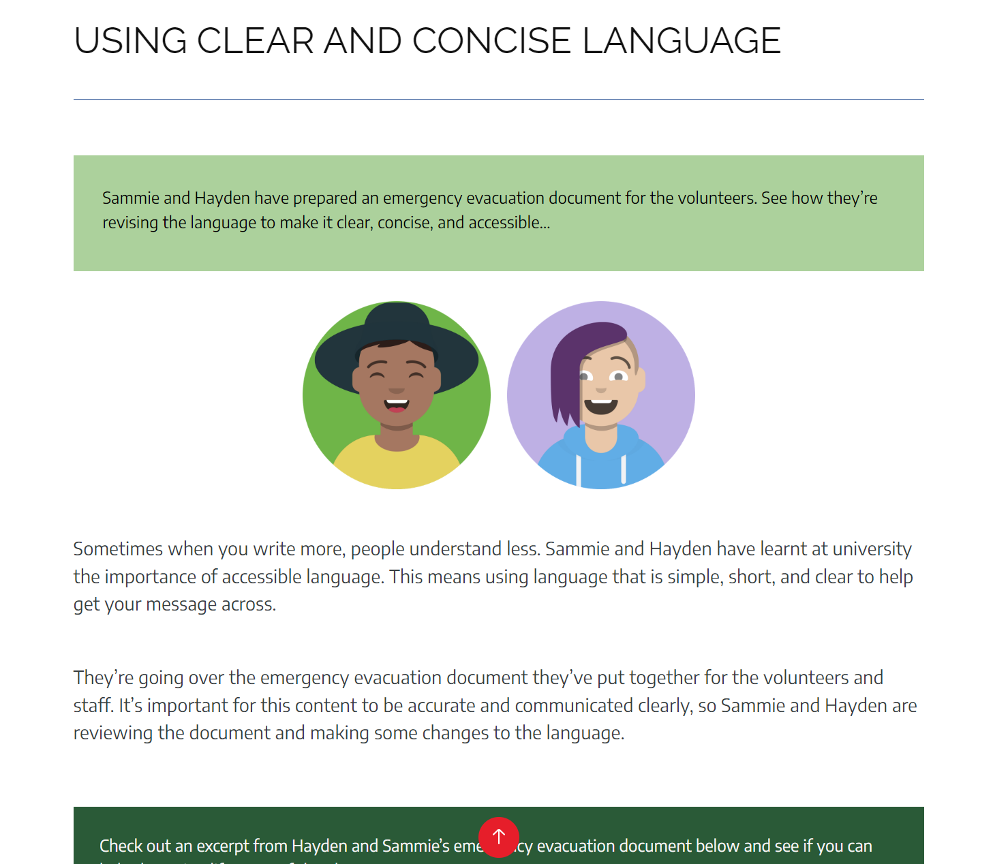
Stage 3 - Development
Pressbooks

Slide 11
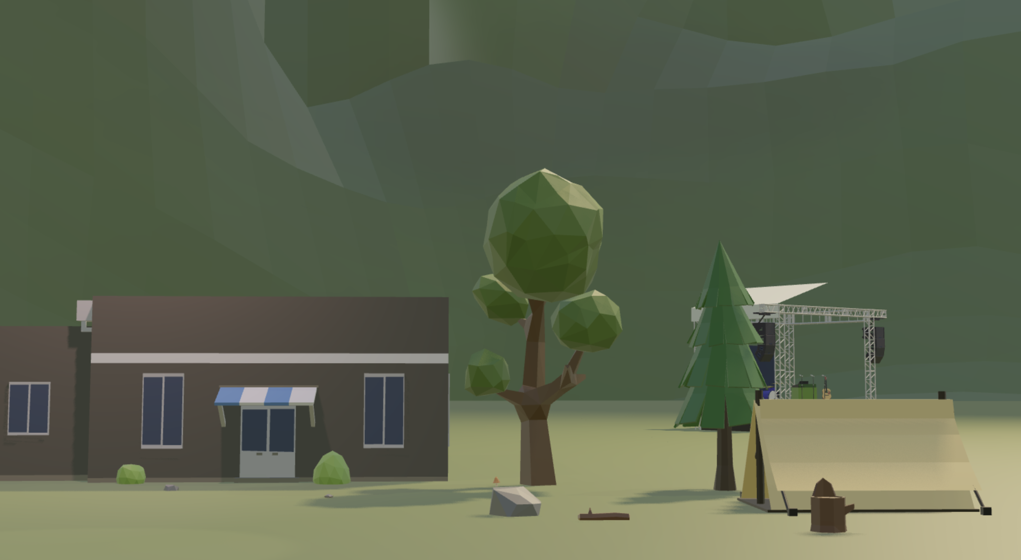
Stage 3 - Development
Virtual 3D map

Slide 12
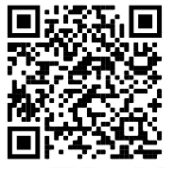
Key takeaways
Addressing inequity:
Research and mapping of equity enrolment data.
Creating innovative and shareable resources:
Guidelines of Representation, Relevance, Reassurance, and Reliability.
Developing content:
Two different environments to address the needs of our cohort who may face technological barriers.
Thank you
You can Learn more about our project on The HEPPP funded initiative page.

